Slide 1
The Intel new mexico Family & Friends amazing Car experience
April 23rd 8:30am – 3:00pm
Intel Maker Nation
presents
Brought to you by NM Makers: Brian Baltz, Allison Barnes, David Manzanares, Todd Marsh, Dan Mcculley, Russ McInnis, Noel Paz, Janet Sholar, Alex Fei Event sponsored by Intel Global Brand & Reputation Marketing, Melissa Beers
Notes:
Give credit to IGB&RM and thanks to team for developing the event

Slide 2
Welcome
Intel Maker Nation and NM Makers
Family and Friends Amazing Car Experience
Notes:
Introduce Event Team
Building Layout
Cover Emergency Exits
Restrooms

Slide 3
Today’s Agenda
8:30am – 8:45am
8:45am – 9:30am
9:30am – 11:30am
12:00pm – 12:30pm
12:30pm – 1:45pm
1:45pm – 3:00pm
Welcome
Intro to Arduino 101
Basic Module
Lunch
Intermediate Module
Advanced Module
Notes:
Cover for NM the Device Depot Logistics with Kit
Cover Food/Snack Logistics
Cover Teams may leave at lunch

Slide 4
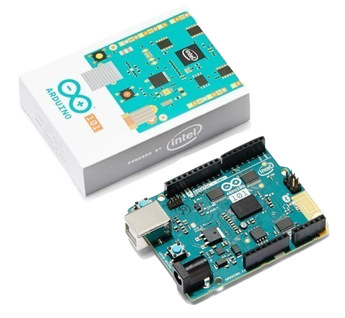
Intro to Arduino 101
Intel Maker Nation and NM Makers
Family and Friends Amazing Car Experience

Slide 5
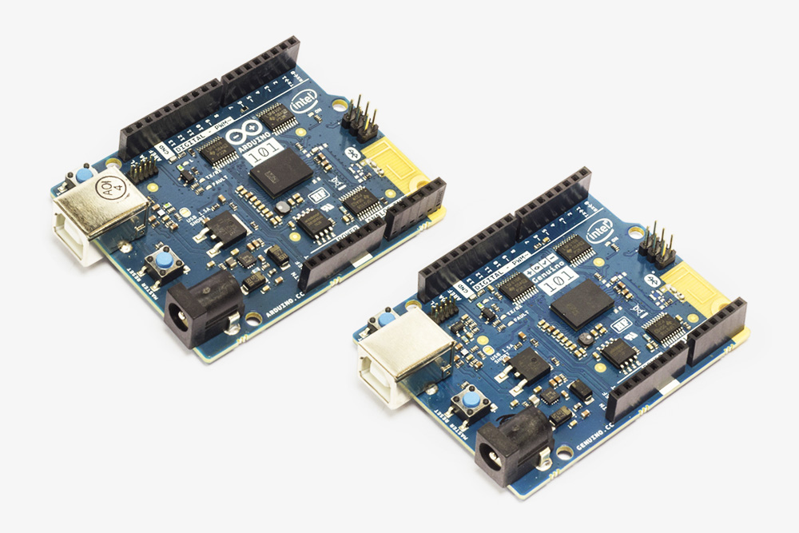
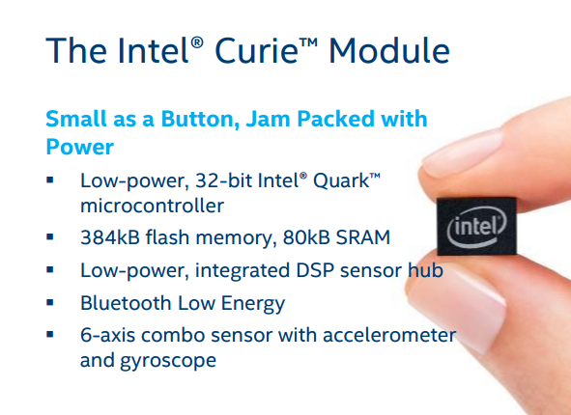
Arduino 101 Board
Arduino 101 & Genuino 101 are updated with the latest technologies. Featuring Intel’s Curie at their core.
Page 5

Slide 6
Arduino Terminology
IDE The Application you use to write code, and send it to the board and communicate with the board.
Sketch the “code” that you write and send to the board to control the I/O pins and anything connected to the board
Shield A printed circuit board/sensors that you connect to the board
Open Source A collective group that contributes to a topic…in this case Arduino and Galileo
Arduino besides being a Bar in Italy...it means “Strong Friend”
Notes:
Let’s go over some terminology related to the Maker movement.

Slide 7
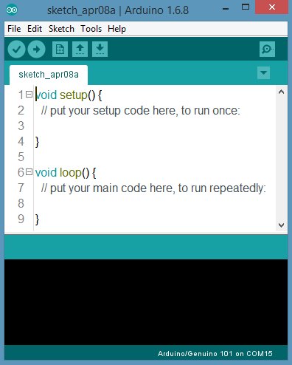
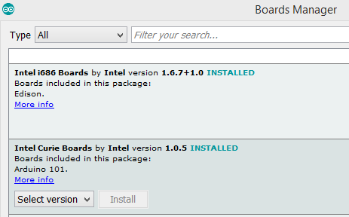
Verify Arduino IDE and Intel Curie Board installed
Arduino IDE should be installed
From - https://www.arduino.cc/en/Main/Software
Intel Curie Boards should be installed
In Arduino IDE Tools -> Board: -> Boards Manager -> Intel Curie Boards INSTALLED
Page 7

Slide 8
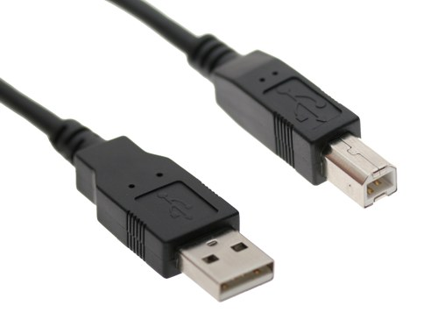
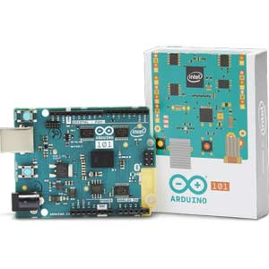
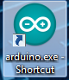
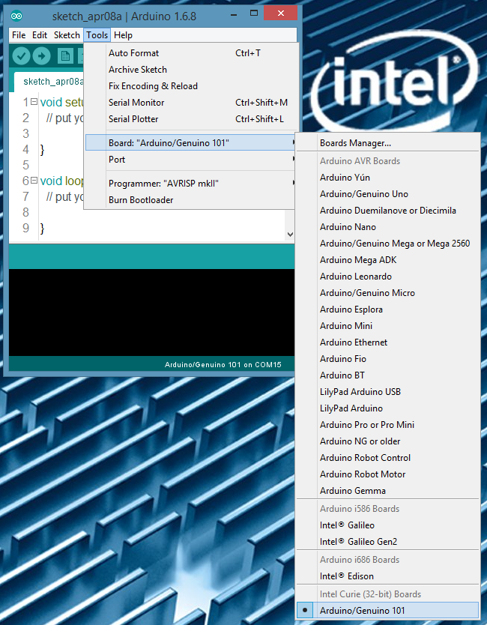
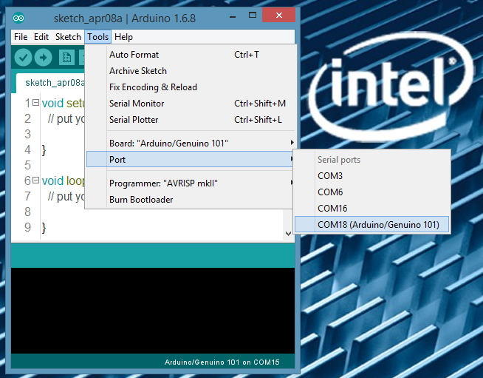
Connect Arduino 101 and Run Blink Sketch
Remove from the Tool Box the
Arduino 101 and the USB cable
Connect the USB cable to the PC and Arduino 101
Power LED comes on once board is connected to PC
Start Arduino IDE
Click arduino.exe shortcut on desktop
Set Model
In Arduino IDE
Tools -> Board -> Arduino101
Set Port
In Arduino IDE
Tools -> Serial Port -> Port*
Page 8

Slide 9
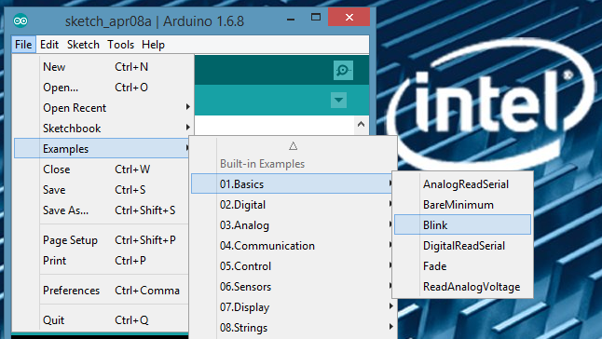
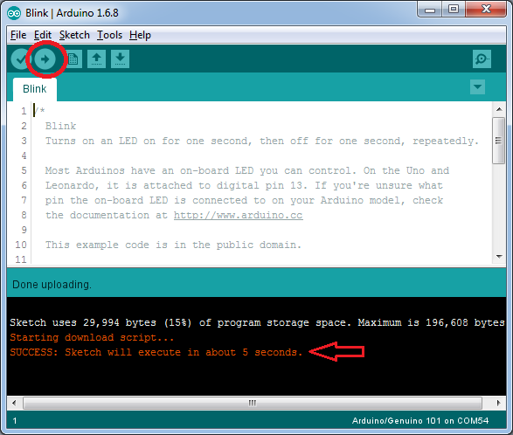
Connect Arduino 101 and Run Blink Sketch (cont.)
With Arduino 101 connected and IDE open.
Start Blink sketch
File-> Examples -> 01. Basics -> Blink
Click Upload button ->
If the upload is successful, the console window will display “SUCCESS”.
Repeat the process if you experience an error. If it fails again, check your Board and Port settings, USB connection and/or device driver.
Page 9
Notes:
Inform that that have to pick board and port
On upload tell them board will disconnect and reconnect from USB/PC
Ask users what happened?

Slide 10
Basic Module
Intel Maker Nation and NM Makers
Family and Friends Amazing Car Experience

Slide 11
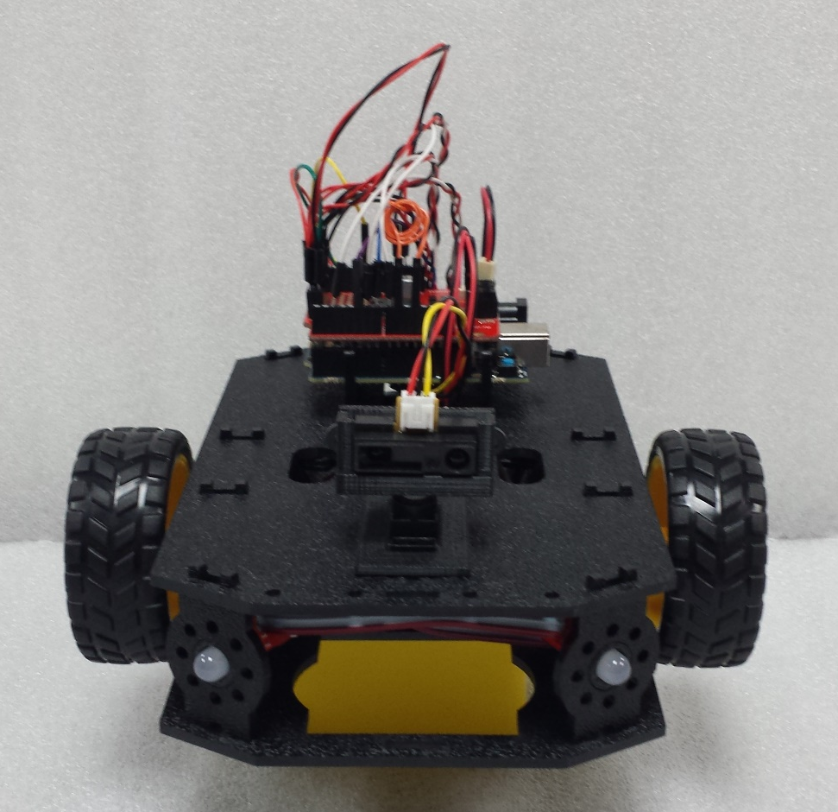
Time to Build our Racer...the Car
Take parts out of Tool Box
Keep your placemat handy, it will help with part identification.
Order of Build:
Bottom Chassis
Encoders
Motors and Wheels
Side Struts
Battery Holder and Batteries
Completed Chassis
Mainboard and Shield
Page 11

Slide 12
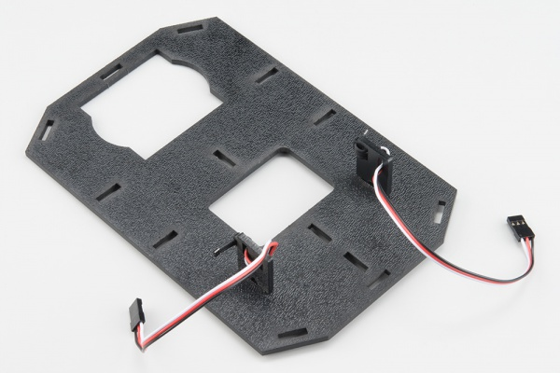
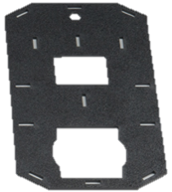
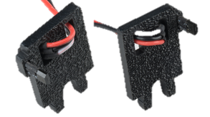
Encoders
Attach Encoders to chassis
Snap the assembled Encoder Mounts (D) into the back left and right vertical slots of the Chassis Bottom Plate (C).
Note the Hall Effect Transistor will need to point to the outside edge of the chassis, and will need to be oriented to the center of the chassis.
1x Chassis Bottom Plate (C)
2x Encoder Mount w/Hall Effect Transistor Left and Right (D)
Page 12

Slide 13
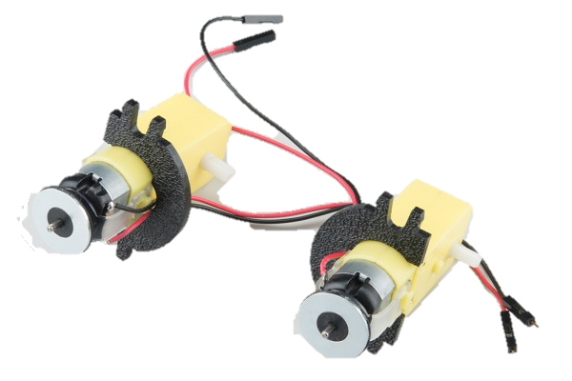
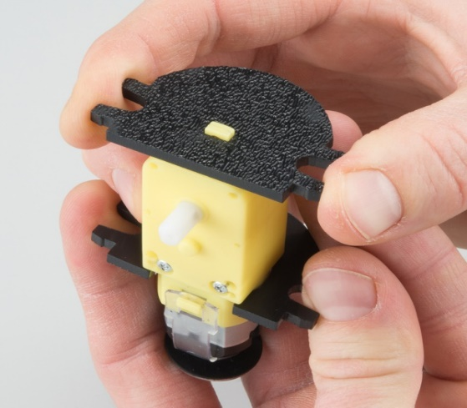
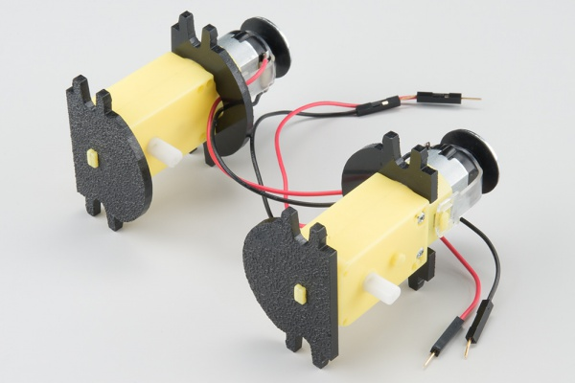
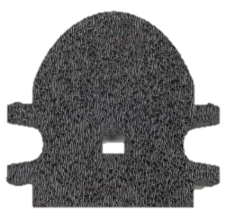
Motors and Mounts
Attach Motor Mounts
Slide a Front Motor Mount (F) onto the protruding eyelet on the front of a Motor (E). Ensure the rounded sides of the motor mounts are facing the same way.
2x DC Motors w/ Rear Mounts and Encoder Magnets (E)
2x Front Motor Mounts (F)
BACK
FRONT
Page 13

Slide 14
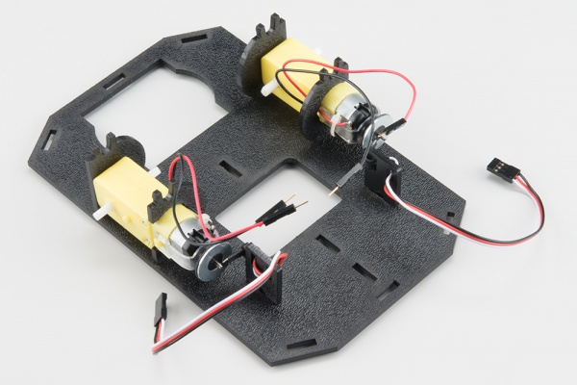
Motors and Mounts (cont.)
Attach the Motor Assemblies to the chassis
Snap the motor assemblies into the set of 2 horizontal slots of the Chassis Bottom Plate (C). Make sure that the rounded edges of the motor mounts and the wires are facing toward the center of the chassis
NOTE: Verify that the Hall Effect sensor is not rubbing against the Magnet (up to a 1/8" away) nor the motor shaft.
Page 14

Slide 15
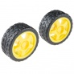
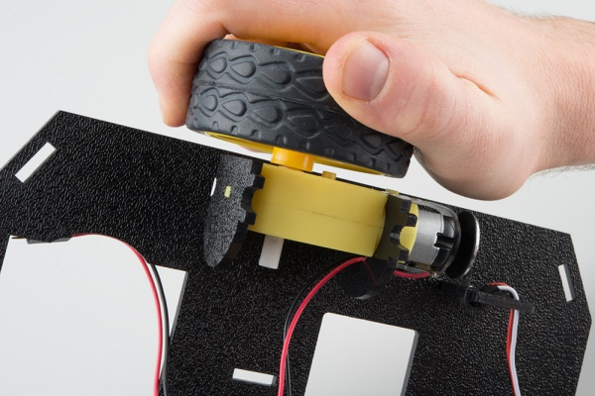
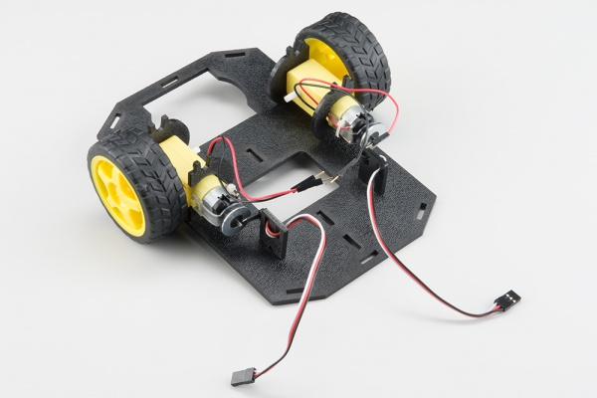
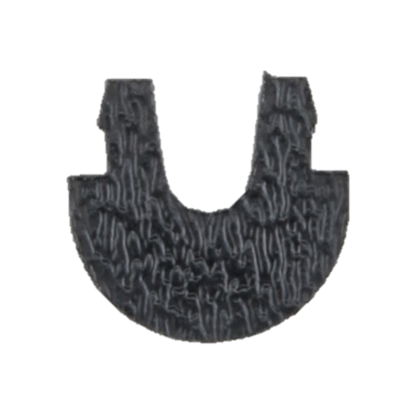
Wheels
Attach the Wheels and Nub Caster
Slide a Wheel (G) onto the plastic shaft of a Motor (E). Notice the motor shaft has two flat edges. Make sure to line up the flat edges of the motor shaft with the flat edges of the wheel.
Snap the Nub Caster (H) into the slot on the back of the Bottom Chassis Plate assembly. Make sure the Nub Caster is on the side opposite the motors (the under-side)
2x Wheel (G)
1x Nub Caster (H)
Page 15

Slide 16
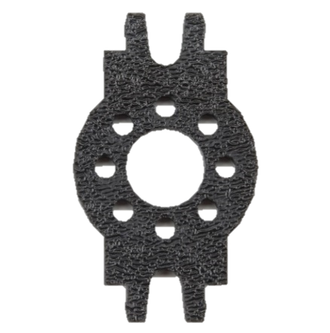
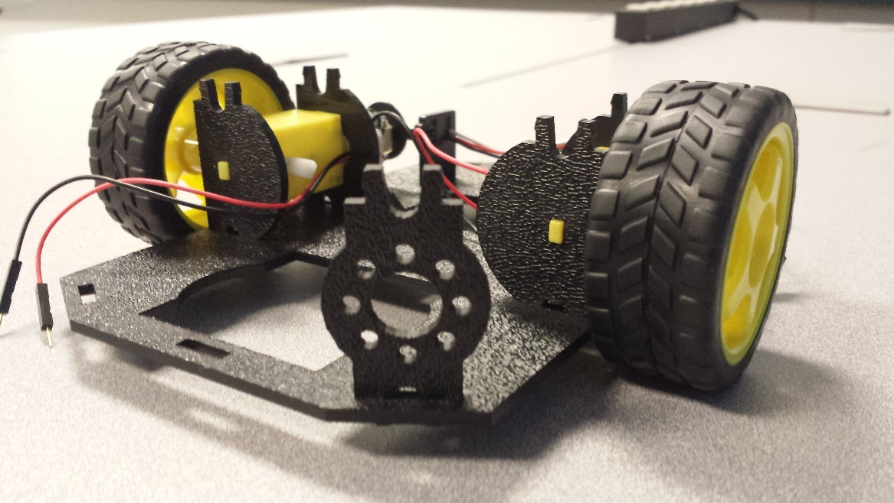
Side Struts
Add the Side Struts
Snap the four Side Struts (I) into the diagonal slots on the four corners of the Chassis Bottom Plate assembly.
4x Side Strut (I)
Page 16

Slide 17
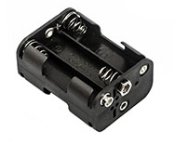
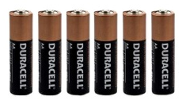
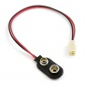
Battery Holder and Batteries
Install the 6 AA batteries into the holder (J). Use care to follow battery polarity.
Attach the battery cable (V) to the holder.
Place battery assembly onto Chassis Bottom plate closest to the nub caster. Place the assembly so the wire is out the back.
1x Battery Holder (w/6 AA Batteries) (J)
1x Battery Cable (V)
Page 17

Slide 18
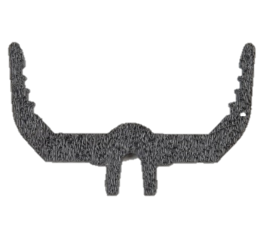
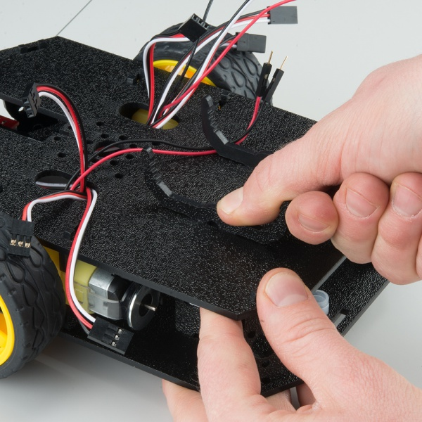
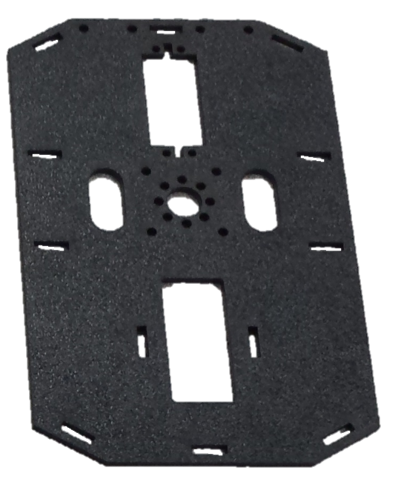
Mainboard Mounts
Attach the Mainboard Mounts
Snap the two Mainboard Mounts (K) into the vertical slots in the back of the Chassis Top Plate (L) near the large rectangular opening.
2x Mainboard Mount (K)
1x Chassis Top Plate (L)
Page 18

Slide 19
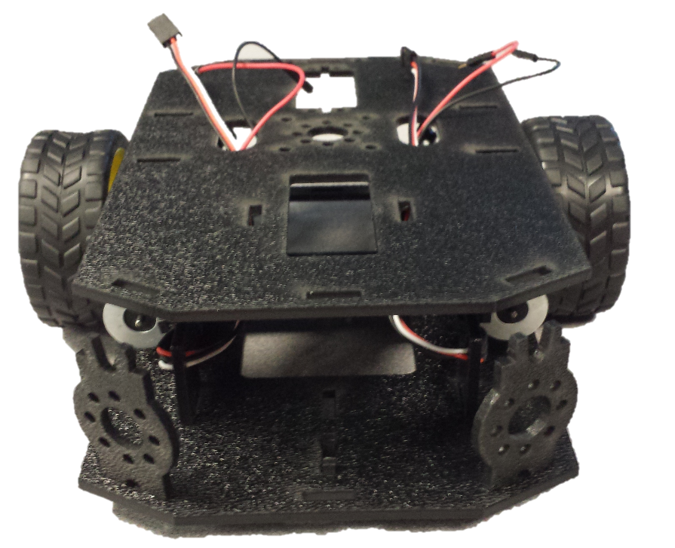
Complete the Chassis
Route the Cables
Position the Chassis Top Plate over the Chassis Bottom Plate – do not snap the two plates together yet. Make sure that the front sides of each plate line up. Mainboard Mounts to the back on top plate, nub caster to the back on bottom plate.
Route the wires and cables through the left and right oval slots in the Chassis Top Plate assembly as shown.
1x Chassis Bottom Assembly
1x Chassis Top Assembly
Page 19

Slide 20
Complete the Chassis (cont)
Attach Chassis Top Plate Assembly to Chassis Bottom Plate Assembly
Line up the Chassis Top Plate on top of all the struts, and carefully snap the Chassis Top Plate assembly onto the side struts and motor mounts. Press carefully and firmly above each side strut and motor mount until they each snap into place in the top chassis plate.
TIP: Start with a Side Strut. Press the top plate onto the strut, then work your way around in a clockwise direction pressing the motor mounts and side strut mounts into the top plate.
1x Chassis Bottom Assembly
1x Chassis Top Assembly
Page 20

Slide 21
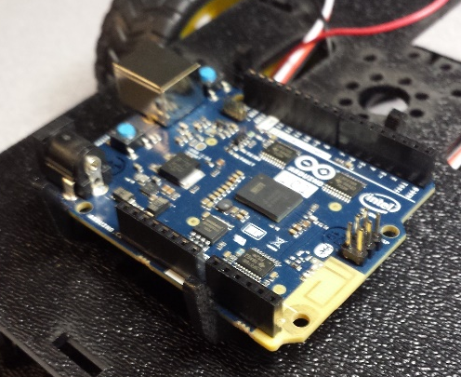
Mainboard
Add the Mainboard
The Arduino 101 Mainboard (A) snaps into the notches on the Mainboard Mounts (K) it will not be down to the lowest notch. Make sure the power jack is facing the left side of the robot (the Mainboard mounts should be closest to you). Push gently and evenly until it snaps into place.
NOTE: While applying downward pressure to the board, gently expand one of the mount legs, and repeat on the other until the mainboard is securely held in the Mainboard Mounts (the Mainboard should not move in the mounts).
1x Arduino 101 (A)
Page 21

Slide 22
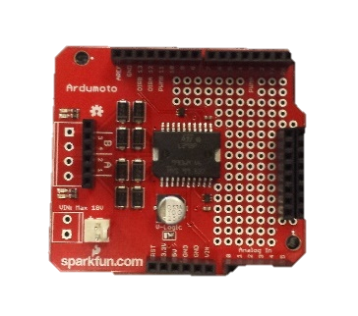
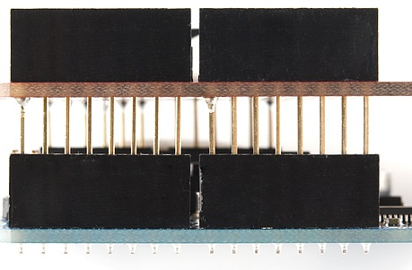
Shield
Add the Shield
Attach the Ardumoto Shield (B) to the Arduino 101 (A).
Match the shape of the shield to the shape of the 101.
Align all of the pins from the shield to the header of the Arduino 101 and gently press the shield onto the mainboard.
Align the shield all the way to the right (the white connector on the shield needs to be over the USB/power connector edge of the 101)
1x Ardumoto Shield (B)
Page 22

Slide 23
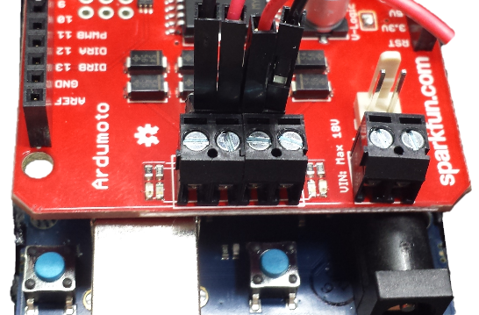
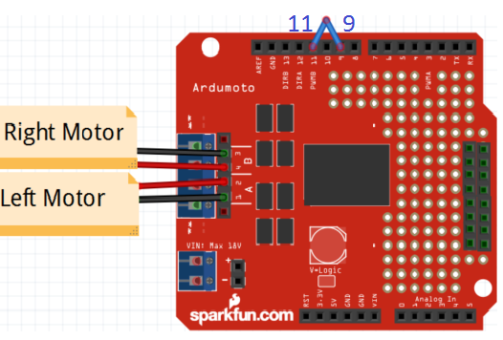
Test Motors
Motor connection to Arduino 101
Left Motor :
Right Motor :
Ardumoto Shield Pins | Left Motor Jumper Wires
LEFT MOTOR - A2 RED | Soldered on Motor Jumper Wire – RED
LEFT MOTOR - A1 BLACK | Soldered on Motor Jumper Wire – BLACK
Add Male to Male Jumper wire from pin 11 to pin 9 of the Ardumoto Shield
Ardumoto Shield Pins | Right Motor Jumper Wires
RIGHT MOTOR – B4 RED | Soldered on Motor Jumper Wire - BLACK
RIGHT MOTOR – B3 BLACK | Soldered on Motor Jumper Wire - RED
 | A |  | B
 | 1 | 2 | 4 | 3
 | Left |  | Right
Page 23

Slide 24
Test Motors (cont.)
With Arduino 101 connected to the PC and the IDE open.
Start Racer Motor Test sketch
File-> examples -> NMMakers_FnF_CarDemo ->testMotor
Attach the battery cable to the Ardumoto shield
Attach the USB to 101 and PC
Upload the Sketch
The motors will run a test pattern
Forward, Right, Left and Backward, Stop
**Tilt/tap the Racer to start the sketch**
Page 24

Slide 25
Maker Racer: Speedway Basic Racer
With Arduino 101 connected to the PC and the IDE open.
It’s time to Race!!!
File-> examples -> NMMakers_FnF_CarDemo ->BasicCar
Upload the Sketch
**Tilt/tap the Racer, at the Start Line of the Race track to start the sketch**
Page 25

Slide 26
Intermediate module
Intel Maker Nation and NM Makers
Family and Friends Amazing Car Experience

Slide 27
Time to add lights and sound to our Racer...the Car
Take parts out of Tool Box
Keep your placemat handy, it will help with part identification.
Order of Build:
RGB LEDs and cable
Completed Chassis
Piezo Buzzer
Page 27

Slide 28
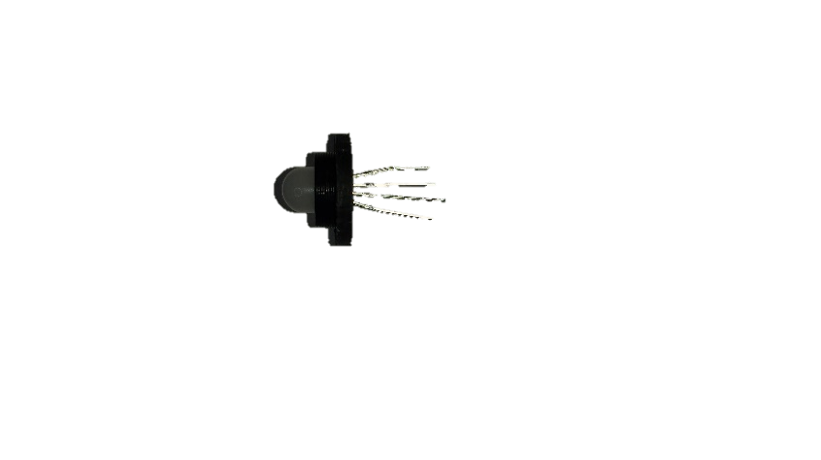
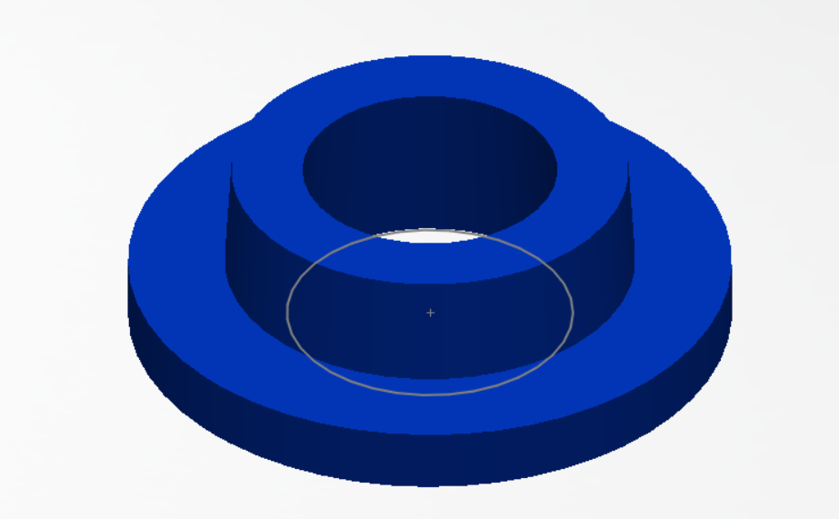
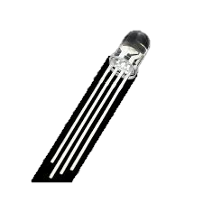
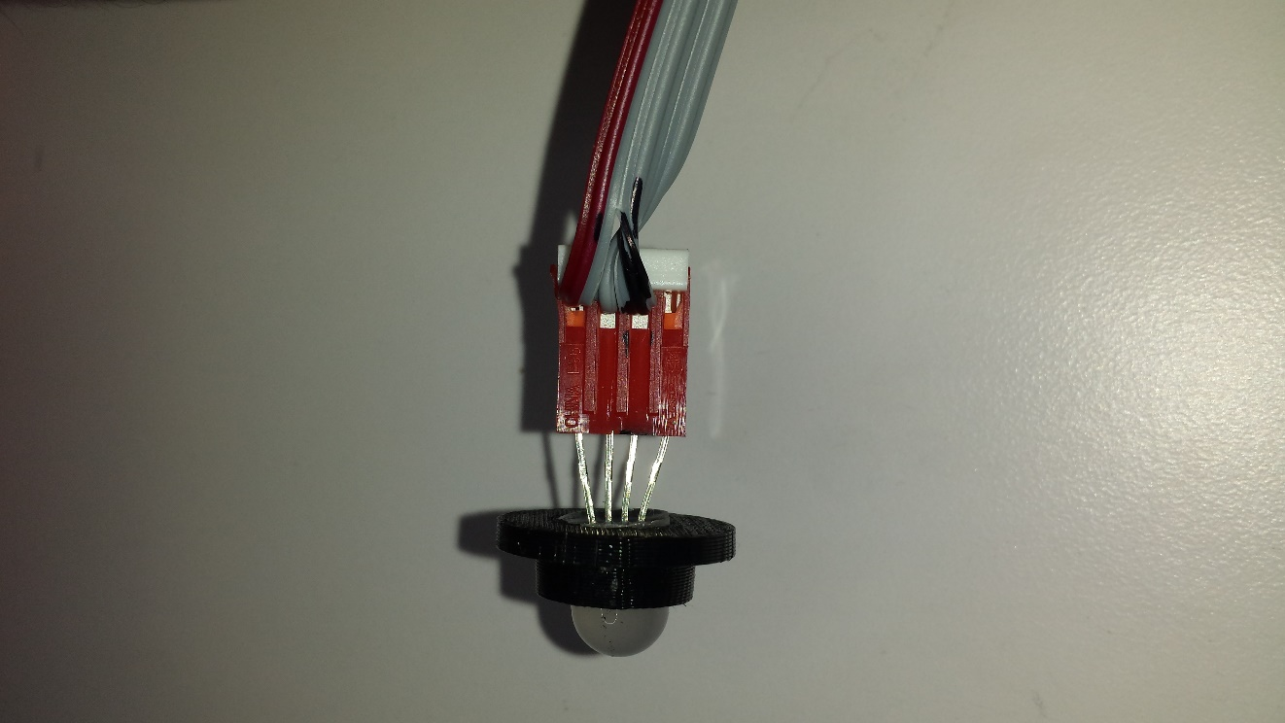
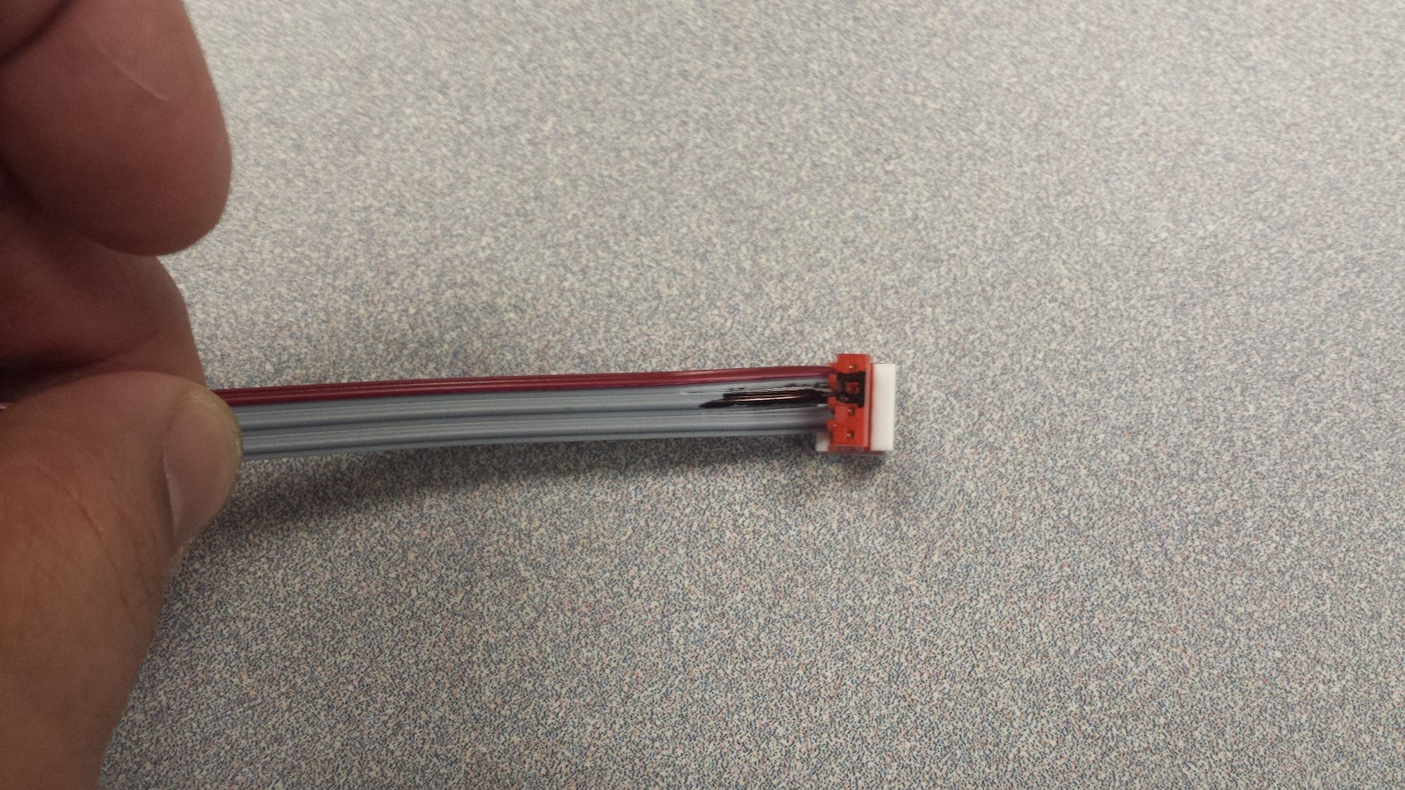
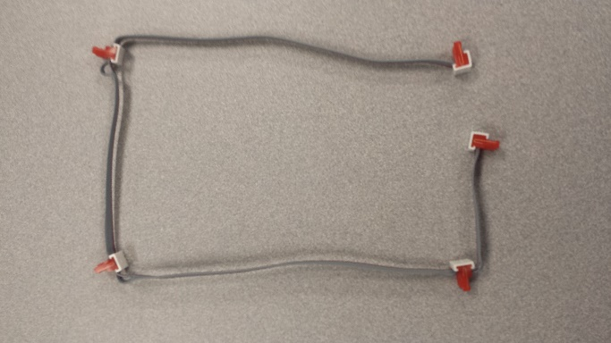
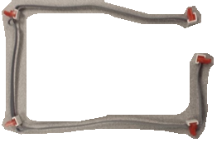
Addressable RGB LEDs and Cable
Insert the RGB LED(M) into the LED Mount (N)
Install the LEDs into the cable connectors, so that the LONGEST lead of the LED is inserted into the Black box on the cable connector.
Do NOT put an LED into the connector on the short end of the cable
NOTE: Fanning out the leads slightly make insertion into the connector easier
The leads will not go entirely into the connector
4x LED Mounts (N)
4x RGB LED(M)
1x LED Cable (O)
Page 28

Slide 29
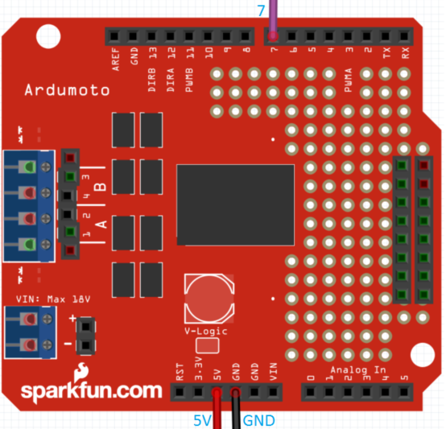
LED Cable and LED Connection Table
LED Cable:
RGB LED leads:
Ardumoto Shield Pins | LED Cable | Jumper Wires
Digital 7 | Data Line (Red wire of LED Cable) | Male to Male - (any color)
POWER Header | 5V | Male to Male - (any color)
GND Header | GND (Black Marked wire of cable and connector) | Male to Male - (any color)
RGB LED leads | LED Cable Connector | LED Cable
Data out |  | Data Line (Red wire of LED Cable)
Ground LONGEST lead of LED | Indicated with Black box | GND (Black marked wire of cable and connector)
V in |  | 5V
Data in |  | Data Line (Red wire of LED Cable)
Page 29

Slide 30
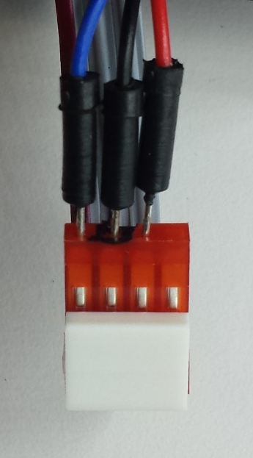
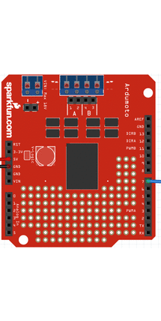
Test LEDs and cable assembly
LED Cable connection to Arduino 101 through Ardumoto Shield
Insert a Male to Male jumper wire into the black hole on the LED cable connector, connect the other end to the shield’s GND pin.
Insert a Male to Male jumper wire into the hole next to the previously inserted wire. The 2 center holes of the connector will now have a wire. The other end of the jumper wire connects to the shield’s 5V pin.
Insert a third Male to Male jumper wire next to the first wire you inserted into the cable connector. The jumper wire you just inserted should line up with the RED wire of the LED cable. Connect the other end of the jumper wire to the shield’s Digital 7 pin.
NOTE: There will be an open (unused) hole in the LED cable connector.
Page 30

Slide 31
Test LEDs and cable assembly (cont.)
With Arduino 101 connected to the PC and the IDE open.
Start Racer LED Test sketch
File-> examples -> NMMakers_FnF_CarDemo -> testLED
Upload the Sketch
All LEDs should light up, then
“Head lights,” “Brake lights,” and finally “Turn Signals.”
**Tilt/tap the Racer to start the sketch**
Page 31

Slide 32
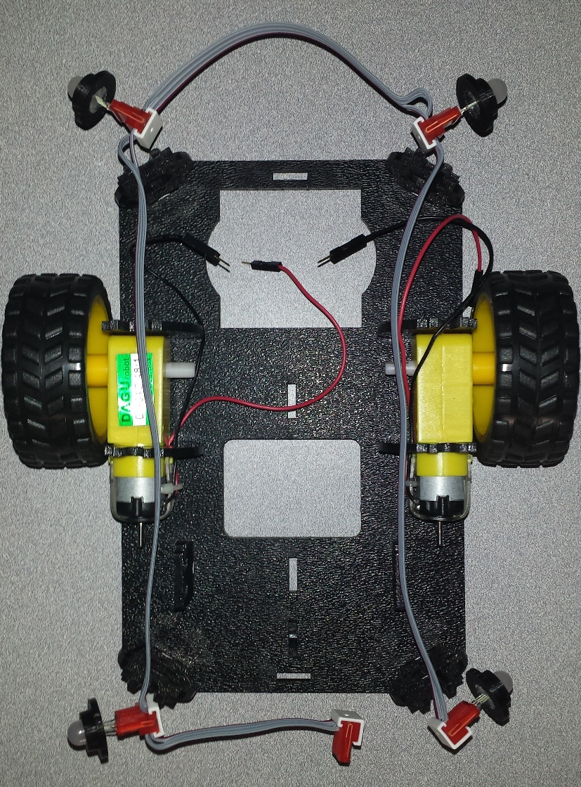
Install LED cable w/LEDs and mounts into chassis
Route the LED cable into the chassis
Start with the short end of the cable in the center back of the chassis and route cable clockwise
Install the LEDs w/mounts into the Side Struts in the chassis corners
NOTE: The cable must not interfere with the encoders on the motors.
1x LED Cable (O) with LEDs (M) and Mounts (N)
Page 32

Slide 33

Creating a 5V and GND Header on the Ardumoto Shield
Some of our components need a 5V connection or a GND connection to the Arduino 101 through the Ardumoto Shield.
To do this we need to create 2 Header Rails... one for 5V the other for GND.

Slide 34


Piezo Buzzer
Buzzer
Every robot should be able to make some sounds. Adding the buzzer (P) will allow you to give your Racer a little personality with its own beeps and bops.
Add the Buzzer
Attach one wire to the GND header, the other to Digital pin 5 on the Ardumoto shield (B).
1x Piezo Buzzer (P)
Page 34

Slide 35
Test Piezo Buzzer
With Arduino 101 connected to the PC and the IDE open.
Start Racer Buzzer Test sketch
File-> examples -> NMMakers_FnF_CarDemo -> testBuzzer
Upload the Sketch
The buzzer will run a test pattern
Can you hear a sound?
**Tilt/tap the Racer to start the sketch**
Page 35

Slide 36
Maker Racer: Supernationals Intermediate Racer
With Arduino 101 connected to the PC and the IDE open.
It’s time to Race!!!
File-> examples -> NMMakers_FnF_CarDemo ->IntermediateCar
Upload the Sketch
**Tilt/tap the Racer at the Race Track Start Line to start the sketch**
Page 36

Slide 37
Advanced Module
Intel Maker Nation and NM Makers
Family and Friends Amazing Car Experience

Slide 38
Time to add intelligence to our Racer...the Car
Take parts out of Tool Box
Keep your placemat handy, it will help with part identification.
Order of Build:
Top Chassis
Servo Motor
IR Proximity Sensor
Page 38

Slide 39


Servo Motor and mount
Install Servo Motor (Q) into Mount (R)
Install Mount with Servo Motor into the Chassis Top plate rectangle in the front. Route the servo motor cable to the mainboard.
1x Servo Motor (Q)
1x Servo Motor Mount (R)
Page 39

Slide 40



IR Proximity Sensor and Mount
Install IR Proximity Sensor (S) into the Mount (T)
Attach the Cable to the sensor. Note the connector is keyed i.e. it only fits one way.
Attach the Mount with sensor and cable to the Servo.
1x IR Proximity Sensor (S) w/JST Cable
1x Proximity Sensor Mount (T)
Page 40

Slide 41


Test Servo Motor and IR Proximity Sensor
Servo Motor:
IR Proximity Sensor:
Ardumoto Shield Pins | Servo Motor Cable | Jumper Wires
Digital 6 | Control Line | Male to Male - (any color)
POWER Header | 5V | Male to Male - (any color)
GND Header | GND | Male to Male - (any color)
Ardumoto Shield Pins | JST Cable from Sensor | Jumper Wires
Analog 0 | Data Line | Male to Male - (any color)
POWER Header | 5V | Male to Male - (any color)
GND Header | GND | Male to Male - (any color)
Page 41

Slide 42
Test Servo Motor and IR Proximity Sensor
With Arduino 101 connected to the PC and the IDE open.
Start Racer Servo and Proximity Test sketches
File-> examples -> NMMakers_FnF_CarDemo -> testServo
Upload the Sketch
**Tilt/tap the Racer to start the sketch**
The Servo will run a test pattern
With the Proximity Sensor installed on the servo motor you will see the sensor sweep left and right.
File-> examples -> NMMakers_FnF_CarDemo -> testProximity
Upload the Sketch
**Tilt/tap the Racer to start the sketch**
The IR Proximity Sensor will run a test pattern
The Proximity Sensor will report to the IDE Serial Monitor the distance to an object.
Page 42

Slide 43
Maker Racer: Road Rally Advance Racer
With Arduino 101 connected to the PC and the IDE open.
It’s time to Race!!!
File-> examples -> NMMakers_FnF_CarDemo ->AdvancedCar
Upload the Sketch
**Tilt/tap the Racer at the Race Track Start line to start the sketch**
Page 43

Slide 44
Smart and Connected Module
Intel Maker Nation and NM Makers
Family and Friends Amazing Car Experience

Slide 45

Let’s make our Racer an Internet of Things device
The Arduino 101 has integrated Bluetooth capabilities!
You will need a device with Bluetooth capabilities as well to connect to the car. Such as a Smart Phone or PC or Tablet.
How to connect:
With Arduino 101 connected to the PC and the IDE open.
It’s time to control our Racer!!!
File-> examples -> NMMakers_FnF_CarDemo ->ConnectedCar
Upload the Sketch
Page 45

Slide 46
Backup Material
Arduino 101 Quick Start
Intel Boards Quick Comparison
Amazing Car Experience
Parts Placemat
Connection Tables

Slide 47

Test Encoders
Encoder connection to Arduino 101
Left Wheel Encoder:
Right Wheel Encoder:
Ardumoto Shield Pins | Left Wheel Encoder | Jumper Wires
Digital 2 | OUT (white) | Male to Male - (any color)
POWER Header | 5V (Red) | Male to Male - (any color)
GND Header | GND (Black) | Male to Male - (any color)
Ardumoto Shield Pins | Right Wheel Encoder | Jumper Wires
Digital 8 | OUT (white) | Male to Male - (any color)
POWER Header | 5V (Red) | Male to Male - (any color)
GND Header | GND (Black) | Male to Male - (any color)

Slide 48



Arduino IDE and Curie Boards
Download and install IDE
Go to https://www.arduino.cc/en/Main/Software and download the Arduino IDE for your OS. (Arduino 1.6.8 is the preferred version)
Install Arduino/Genuino 101 Core
Double click on Arduino.exe shortcut
In Arduino IDE, launch boards manager: Tools -> Board: -> Boards Manager
Highlight Intel Curie Boards, and click Install
You will be prompted multiple times to accept the driver/device software. Click Install for each prompt.
Page 46

Slide 49

Intel’s MicroComputer Comparison
Page 47

Slide 50

Arduino/Genuino 101 Specifications
Page 48

Slide 51

Amazing Car Experience - Parts Placemat
Page 49

